Slide 1
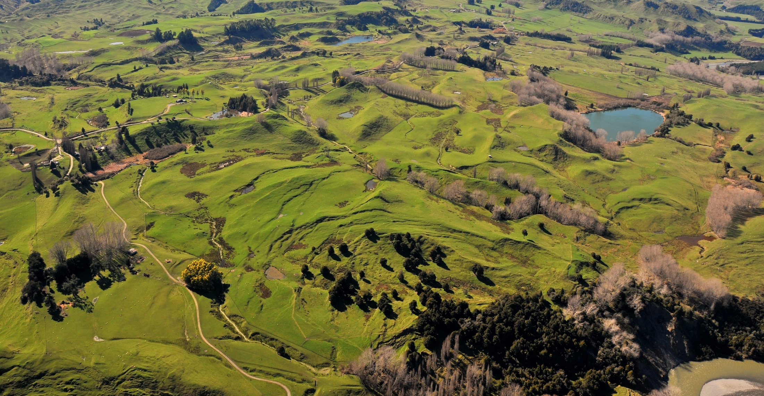
Operationalizing InSAR and Pixel Offset Time Series Methodologies for Landslide Monitoring
AGU Fall Meeting Dec 16th, 2021
f.williams1@massey.ac.nz
Notes:
Hello everyone, I’m a student at Massey University in New Zealand
static landslide inventories are common throughout the world

Slide 2
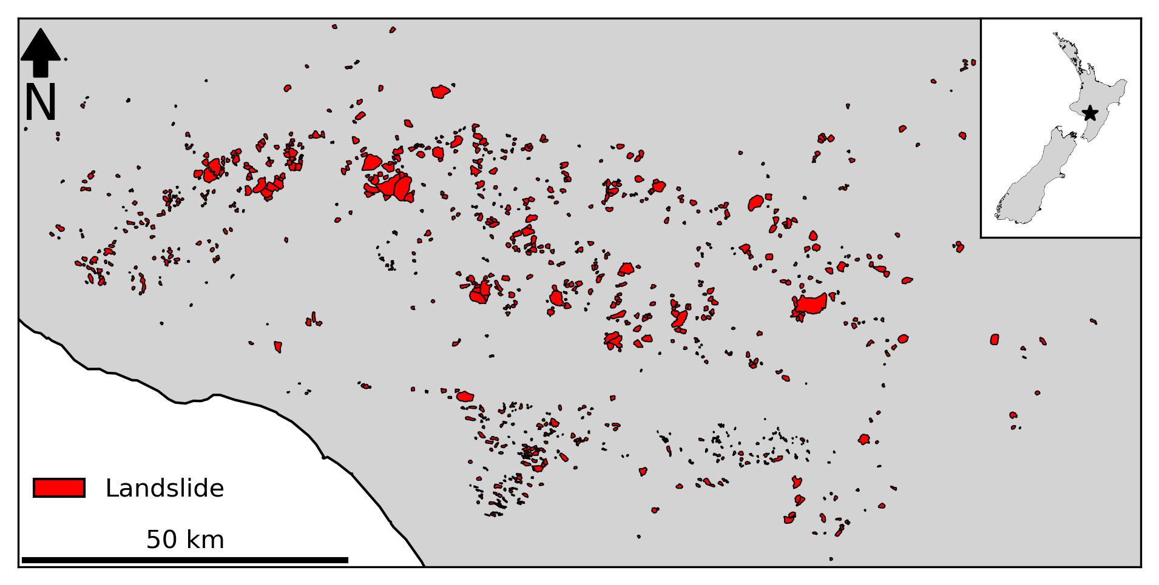
f.williams1@massey.ac.nz
Notes:
Just like many other landslide inventories many of these features are likely inactive today
Important question: which landslides are active and where are they
InSAR has long promised to solve this issue
Low coherence and small spatial signal in natural

Slide 3
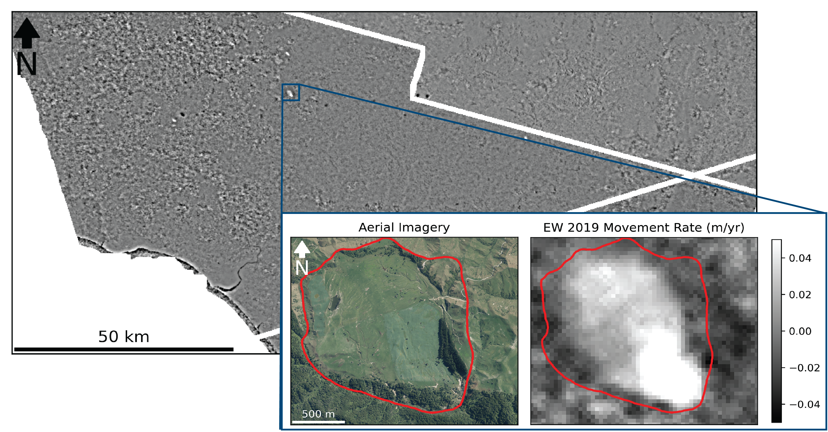
f.williams1@massey.ac.nz
Notes:
We’ve combined the latest time-series InSAR techniques and pixel-offset tracking techniques into a framework for updating landslide inventories with activity information
Better still, we utilize cloud-computing services like the Alaska satellite facility’s H Y P 3 interferogram generation service to reduce the computational expense of our analysis, and the entire workflow is written in Python jupyter notebooks with open-source tools that are publicly available on my GitHub repository.
Here we have the east to west movement rate of our entire study area in 2019 where we have also highlighted a notable active landslide

Slide 4
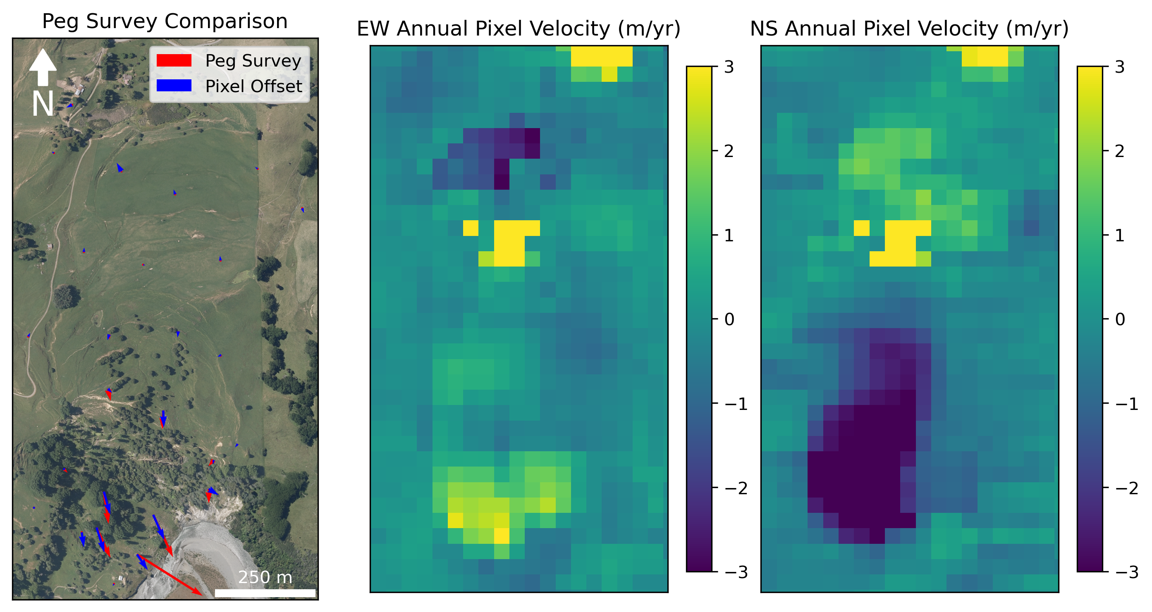
f.williams1@massey.ac.nz
Notes:
While we have seen that InSAR is capable of detecting movement in landslides that are moving at least 5 m/yr, the estimated velocity is often off by two orders of magnitude or more
Consequently, we also implement a timeseries pixel offset analysis using the new AutoRIFT python program for all active landslides
This technique does a much better job of tracking landslides whose movement rates exceed 1 m/yr
We have found that the results are very to a recent peg survey that was conducted between 2015 and 2019 at one of our landslides

Slide 5

Questions:
Email: f.williams1@massey.ac.nz
GitHub: forrestfwilliams
Twitter: @rs_forrest
Workflows:
InSAR: github.com/forrestfwilliams/hyp3_insar
Pixel Offset: github.com/forrestfwilliams/pixeloffset_mintpy
Data + Figures: github.com/forrestfwilliams/agu_2021
Thank you to Graham Hancox for the Rangitikei Landslide photography
f.williams1@massey.ac.nz
Notes:
We’ve completed the proof of concept phase of this analysis and we’re excited to extend the analysis to our full study area
Additionally we are currently partnering with Descartes Labs, a geospatial analysis company, to perform this analysis in a larger portion of New Zealand
Thank you for listening, you can contact via the conference app, email or twitter, and the workflows I presented today can be found at the github repositories listed here
Automatically identifying landslides signals in InSAR data
Estimating sediment output of landslides using pixel-offset data

Slide 6
Supplementary Slides
f.williams1@massey.ac.nz
Notes:
This flowchart gives a schematic overview of our workflow. I will cover each step briefly, but I am also happy to share that the entirety of this workflow uses open-source tools and is fully contained with Python Jupyter Notebooks that are freely available on GitHub at the links provided at the end of this presentation.
We hope that these notebooks will assist others who would like to perform a similar analysis and we welcome any suggestions you have for improving our analysis on these GitHub pages.
Broadly, our workflow can be divided into two separate analyses. The first is a SBAS InSAR workflow that utilizes Sentinel 1 data, and the other is a pixel-offset analysis that utilizes Sentinel 2 data. As anyone who has performed these types of analyses knows, these analyses can be very resource intensive both in terms of compute power and data storage, because of this we have utilized cloud-computing frameworks to do much of the initial data processing.
For the InSAR analysis, we have utilized the Alaska Satellite Facility’s fantastic HyP3 program, which uses Amazon Web Services and Sentinel-1 data, to generate on-demand interferograms which we use in our analysis. We requested interferograms with the nearest three acquisitions in time for each SLC that intersected our study area (including both the ascending and descending orbits).
These interferograms were loaded into mintpy, a python-based SBAS InSAR timeseries tool, where the SBAS analysis was conducted. Prior to the timeseries inversion, a double difference filter was applied to all interferograms. This filter is described in Dr. Bekaert’s 2020 paper in Remote Sensing of Environment and is the difference between local average and regional average filter.
For the local average filter, a diameter of 200 m was used, and for the regional filter, a 2 km diameter was used. This filter is ideal for identifying local sources of deformation like landslides because it removes spatially-correlated tropospheric phase delays at the local level without introducing artifacts. Additionally, the filter tends to make the final velocity prediction less dependent on the choice of reference point, which increases the utility of large-scale analyses. Once the filter has been applied to the interferograms, the timeseries inversion is performed, and a linear timeseries velocity is estimated.
Similar to other studies like Bekaert et al 2020, we found that there were large seasonal variations in spatial coherence which made it infeasible to perform a multi-year analysis.
Consequently, each year of InSAR data was processed separately, which led to much better results. Once the velocity was estimated for each Sentinel-1 scene, scenes in the same orbit were merged, then velocity maps form the ascending and descending path were combined to estimate the velocity predictions in the east-west and vertical directions.
By looking for previously mapped landslides that also showed a strong signal in the insar velocity maps, we identified landslides that are likely to be active and we then performed the pixel offset analysis in these locations.
For the pixel offset analysis, we used Microsoft’s Planetary Computer to identify and download a subset of cloud-free images over each active landslides. We found that performing pixel offset tracking on images that were acquired less than a year apart led to a large increase in the noise of our results, so we selected a set of yearly images that were taken in roughly the same month.
Using the new AutoRIFT pixel offset tracking software, we performed pixel offset tracking on all possible pairs of images, then imported the results into MintPy. In mintpy, we performed a timeseries inversion on the pixel tracking results, then estimated the linear velocity in a manner similar to the InSAR workflow.
Using these analyses, we believe we have developed a reproducible framework for identifying the activity state of previously mapped landslides. While this work is still ongoing, we are excited to share some initial results with you.

Slide 7
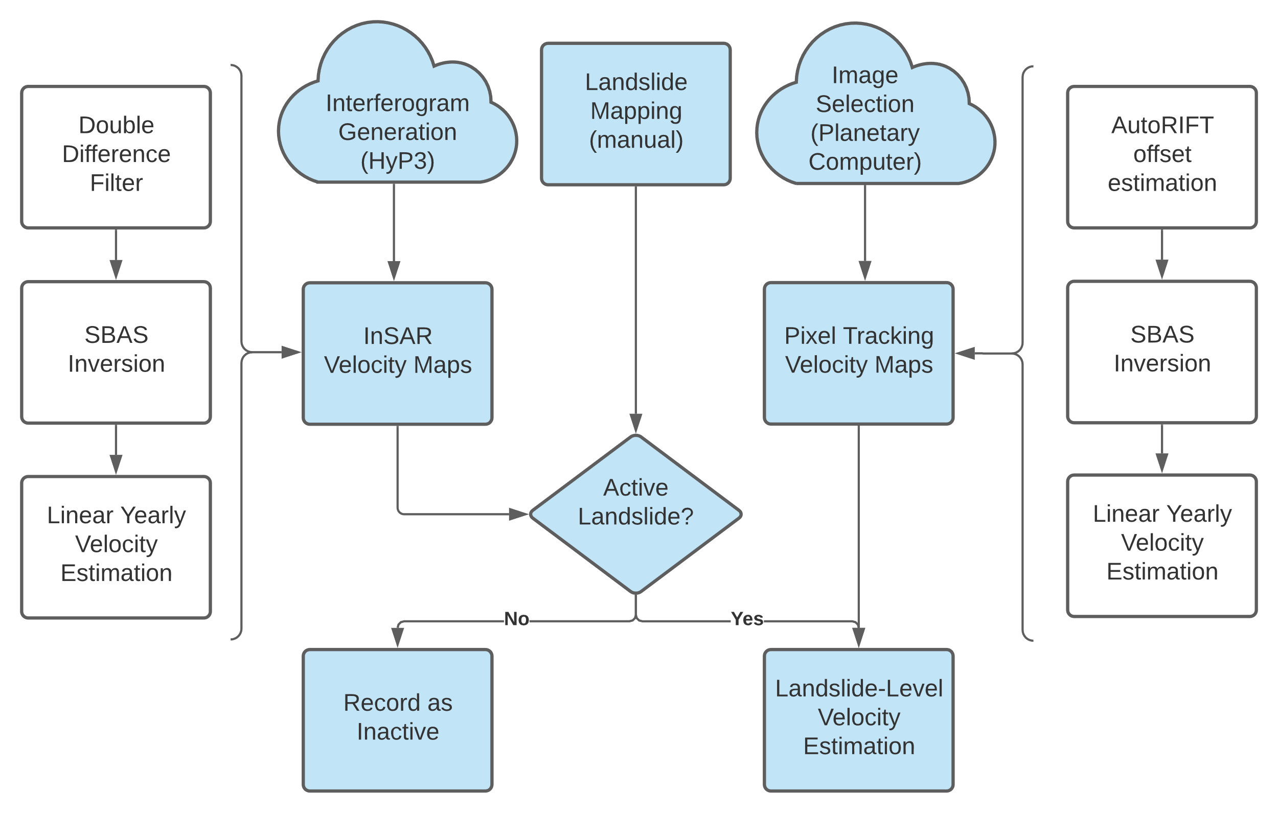
f.williams1@massey.ac.nz
Notes:
This flowchart gives a schematic overview of our workflow. I will cover each step briefly, but I am also happy to share that the entirety of this workflow uses open-source tools and is fully contained with Python Jupyter Notebooks that are freely available on GitHub at the links provided at the end of this presentation.
We hope that these notebooks will assist others who would like to perform a similar analysis and we welcome any suggestions you have for improving our analysis on these GitHub pages.
Broadly, our workflow can be divided into two separate analyses. The first is a SBAS InSAR workflow that utilizes Sentinel 1 data, and the other is a pixel-offset analysis that utilizes Sentinel 2 data. As anyone who has performed these types of analyses knows, these analyses can be very resource intensive both in terms of compute power and data storage, because of this we have utilized cloud-computing frameworks to do much of the initial data processing.
For the InSAR analysis, we have utilized the Alaska Satellite Facility’s fantastic HyP3 program, which uses Amazon Web Services and Sentinel-1 data, to generate on-demand interferograms which we use in our analysis. We requested interferograms with the nearest three acquisitions in time for each SLC that intersected our study area (including both the ascending and descending orbits).
These interferograms were loaded into mintpy, a python-based SBAS InSAR timeseries tool, where the SBAS analysis was conducted. Prior to the timeseries inversion, a double difference filter was applied to all interferograms. This filter is described in Dr. Bekaert’s 2020 paper in Remote Sensing of Environment and is the difference between local average and regional average filter.
For the local average filter, a diameter of 200 m was used, and for the regional filter, a 2 km diameter was used. This filter is ideal for identifying local sources of deformation like landslides because it removes spatially-correlated tropospheric phase delays at the local level without introducing artifacts. Additionally, the filter tends to make the final velocity prediction less dependent on the choice of reference point, which increases the utility of large-scale analyses. Once the filter has been applied to the interferograms, the timeseries inversion is performed, and a linear timeseries velocity is estimated.
Similar to other studies like Bekaert et al 2020, we found that there were large seasonal variations in spatial coherence which made it infeasible to perform a multi-year analysis.
Consequently, each year of InSAR data was processed separately, which led to much better results. Once the velocity was estimated for each Sentinel-1 scene, scenes in the same orbit were merged, then velocity maps form the ascending and descending path were combined to estimate the velocity predictions in the east-west and vertical directions.
By looking for previously mapped landslides that also showed a strong signal in the insar velocity maps, we identified landslides that are likely to be active and we then performed the pixel offset analysis in these locations.
For the pixel offset analysis, we used Microsoft’s Planetary Computer to identify and download a subset of cloud-free images over each active landslides. We found that performing pixel offset tracking on images that were acquired less than a year apart led to a large increase in the noise of our results, so we selected a set of yearly images that were taken in roughly the same month.
Using the new AutoRIFT pixel offset tracking software, we performed pixel offset tracking on all possible pairs of images, then imported the results into MintPy. In mintpy, we performed a timeseries inversion on the pixel tracking results, then estimated the linear velocity in a manner similar to the InSAR workflow.
Using these analyses, we believe we have developed a reproducible framework for identifying the activity state of previously mapped landslides. While this work is still ongoing, we are excited to share some initial results with you.

